Slide 1
Molding and core making
Lecture 4

Slide 2
Conventional Molding Process
Green Sand Molding
Green sand is the most diversified molding method used in metal casting operations. The process utilizes a mold made of compressed or compacted moist sand. The term "green" denotes the presence of moisture in the molding sand. The mold material consists of silica sand mixed with a suitable bonding agent (usually clay) and moisture.

Slide 3
Green Sand Molding
Advantages
Most metals can be cast by this method.
Pattern costs and material costs are relatively low.
No Limitation with respect to size of casting and type of metal or alloy used
Disadvantages Surface Finish of the castings obtained by this process is not good and machining is often required to achieve the finished product.

Slide 4
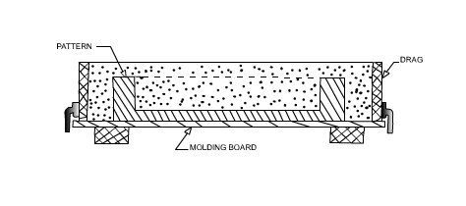
Green Sand Molding Steps
The first step in making mold is to place the pattern on the molding board.
The drag is placed on the board
Dry facing sand is sprinkled over the board and pattern to provide a non sticky layer.
Molding sand is then riddled in to cover the pattern with the fingers; then the drag is completely filled.

Slide 5
Green Sand Molding Steps
The sand is then firmly packed in the drag by means of hand rammers. The ramming must be proper i.e. it must neither be too hard or soft.
After the ramming is over, the excess sand is leveled off with a straight bar known as a strike off bar.
With the help of vent rod, vent holes are made in the drag to facilitate the removal of gases during pouring and solidification.
The finished drag flask is now rolled over to the bottom board exposing the pattern.

Slide 6
Green Sand Molding Steps
Cope half of the pattern is then placed over the drag pattern with the help of locating pins. The cope flask on the drag is located aligning again with the help of pins.
The dry parting sand is sprinkled all over the drag and on the pattern.
A sprue pin for making the sprue passage is located at a small distance from the pattern. Also, riser pin, if required, is placed at an appropriate place.
The operation of filling, ramming and venting of the cope proceed in the same manner as performed in the drag.

Slide 7
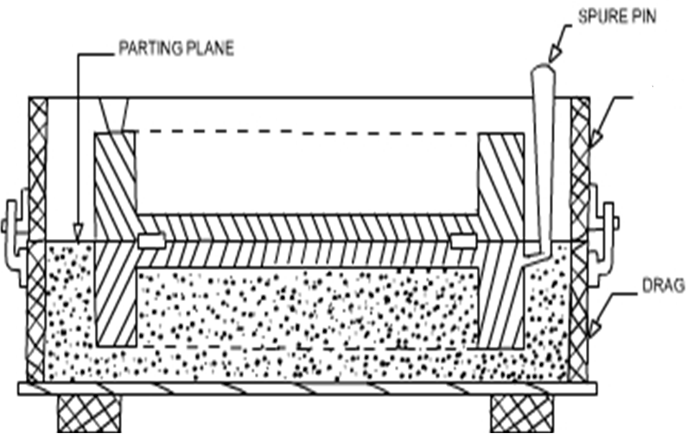
Green Sand Molding Steps
COPE

Slide 8
Green Sand Molding Steps
The sprue and riser pins are removed first and a pouring basin is scooped out at the top to pour the liquid metal.
Then pattern from the cope and drag is removed and facing sand in the form of paste is applied, if required all over the mold cavity and runners which would give the finished casting a good surface finish.
The mold is now assembled. The mold now is ready for pouring

Slide 9
Core
A core is a specialized insert, typically made of sand, that creates hollow spaces or intricate internal features within a cast part.
Cores are used to form internal cavities, recesses, undercuts, and other features in castings that the mold itself cannot create.
Cores are crucial for producing a wide variety of cast components, from engine blocks with internal cooling passages to more complex shapes with internal features.

Slide 10
Core making steps
Selection of Sand: Properties of core sand are highly crucial and are required to have characteristics like permeability, green strength, refractoriness, flowability, collapsibility, adhesiveness, cohesiveness, and dry strength.
Mixing of sand with additives: After thorough mixing of sand, binder is added to the silica sand with moisture content and other additives like coal dust, dextrin, or silica flour to create a mixture.
Blowing or Shooting: Mixture is blown into the core box, This process is also referred to as core shooting process and modern foundries use dedicated core blowing/shooting machines for optimal production.

Slide 11
Core making steps
Venting: It is essential to provide a venting passage gases as if remain entrapped inside the mold, these gases can result in casting defects. Therefore, to obtain good permeability additional venting holes are made in the cores.
Reinforcement of Cores: Some cores, heavy & large cores in particular, might need additional reinforcement material like cast iron grids or low-carbon steel wires to maintain coherence.
Baking of Cores: To obtain strength baking of sand cores is done in conventional oven at temperature between 200° C to 250° C (392° F and 482° F), the heat causes the binder to polymerize.

Slide 12
Core making steps
Cleaning & Finishing: After baking, following methods are used to clean cores -
Trimming of cores involve removing loose pieces and other unwanted projections
Brushing is used to remove loose sand off the core with fine wire brush
Coating is crucial step for finishing and involves coating of cores with refractory material to improve heat resistance.
Inspection: This step includes either manual or machine inspection of the cores for dimensional accuracy.
Assembling: This includes assembling of multiple cores together with core glue and placement of core in mould as in figure provided in next slide.

Slide 13

Assembled Core
FIRST OPERATION
Vents
Weight
Lifter
Riser pin
Sprue pin
Pouring basin
Cope
Riser
Parting
line
Parting
line
Runner
Gate
Core
Mold without core
Mold with core

Slide 14


